Slide 1

Airbnb Visualization Project
By:
Leila Zintsem
Anna Chee
Dan Waehmer
Peter Sparks

Slide 2

What are the popular rental neighborhoods in Chicago, NYC and Seattle? How much does it cost to rent in those neighborhoods? How does the price compare to different rooms?
DEFINING THE QUESTIONS

Slide 3

THE DATA SOURCE
https://www.kaggle.com/airbnb/seattle?select=listings.csv
https://www.kaggle.com/jinbonnie/chicago-airbnb-open-data?select=listings.csv
https://www.kaggle.com/dgomonov/new-york-city-airbnb-open-data?select=AB_NYC_2019.csv

Slide 4
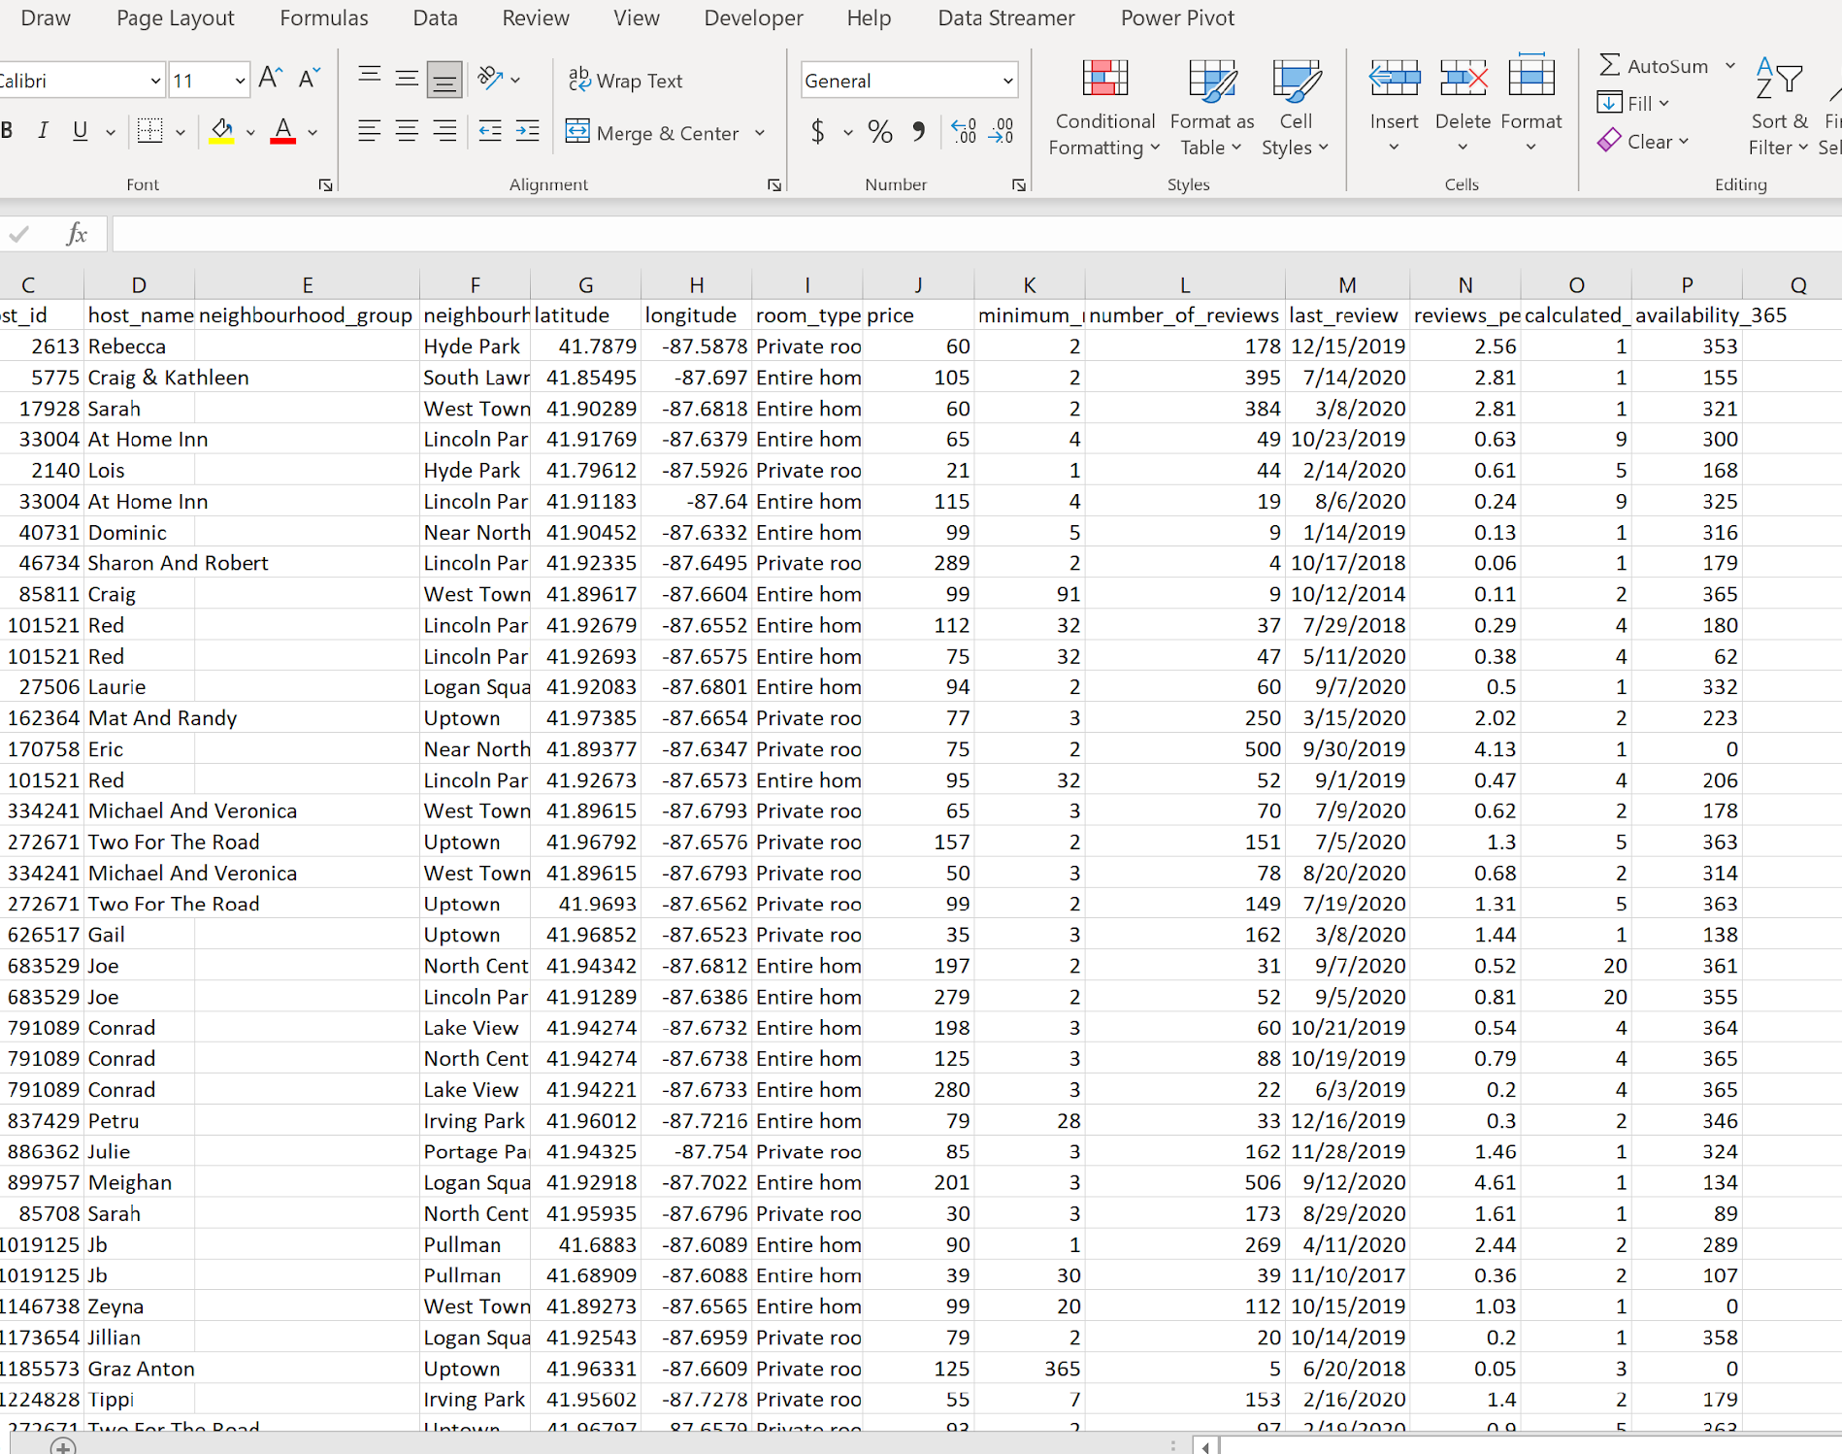
The Datasets
Large datasets Over 22k records
NYC and Chicago same data structure, same columns (14)
Seattle different dataset

Slide 5

DATA CLEANING
DELETED UNECESSARY COLUMNS MANUALLY FOR PERFORMANCE OF CODE
REDUCE DATASET TO 1000 RECORDS
AND 500 (TOP 500 LUXURY ROOMS)
EXTRA SPACE REMOVAL

Slide 6
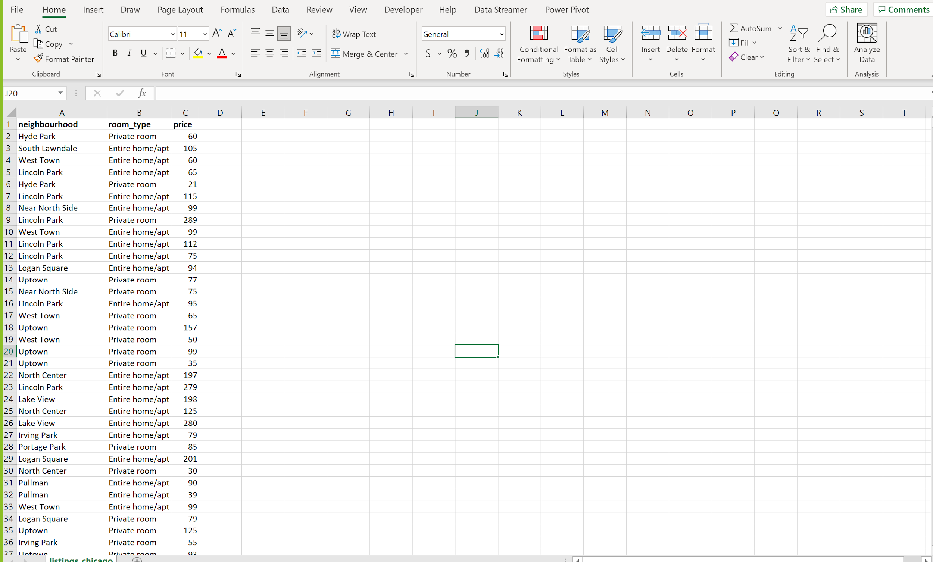
CLEAN DATASET
Data shape:
3 columns
1000 rows

Slide 7

THE VISUALIZATION

Slide 8

The library
Chart.js is a free open-source JavaScript library for data visualization, which supports 8 chart types
<script src=https://cdnjs.cloudflare.com/ajax/libs/Chart.js/3.3.2/chart.min.js
Chart is one of the best js plotting library
Easy to implement

Slide 9
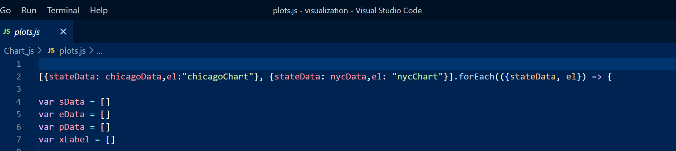
THE CODING

Slide 10
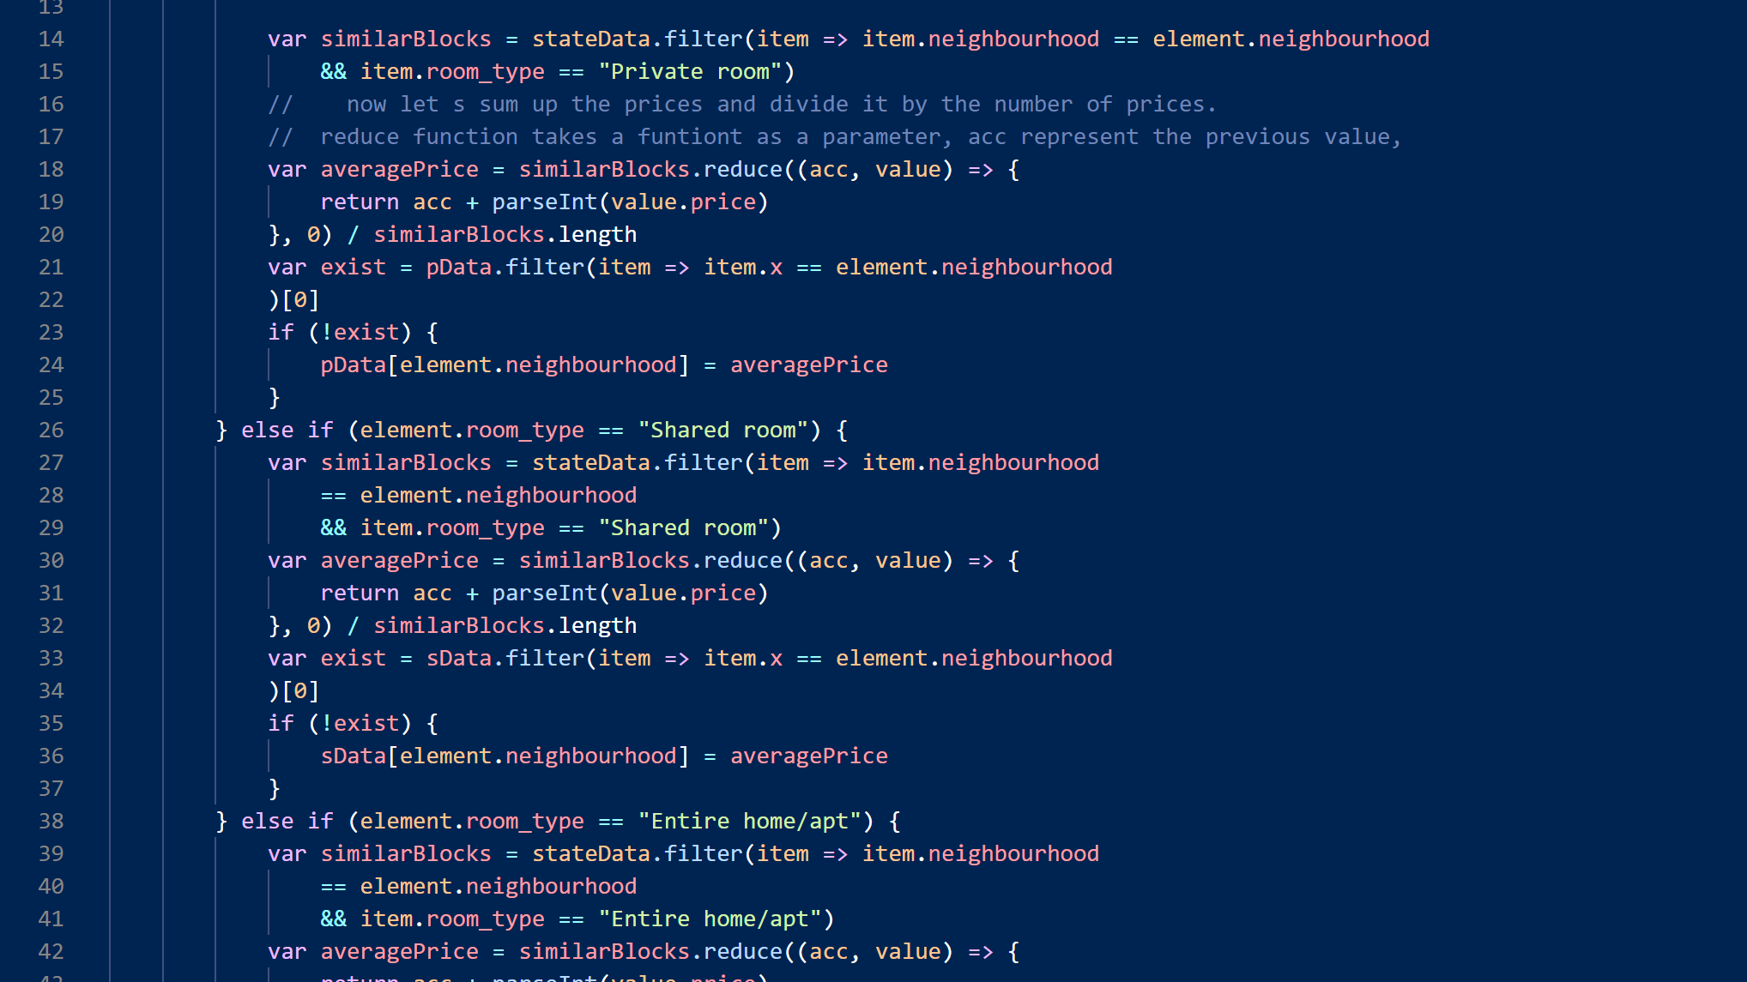

Slide 11
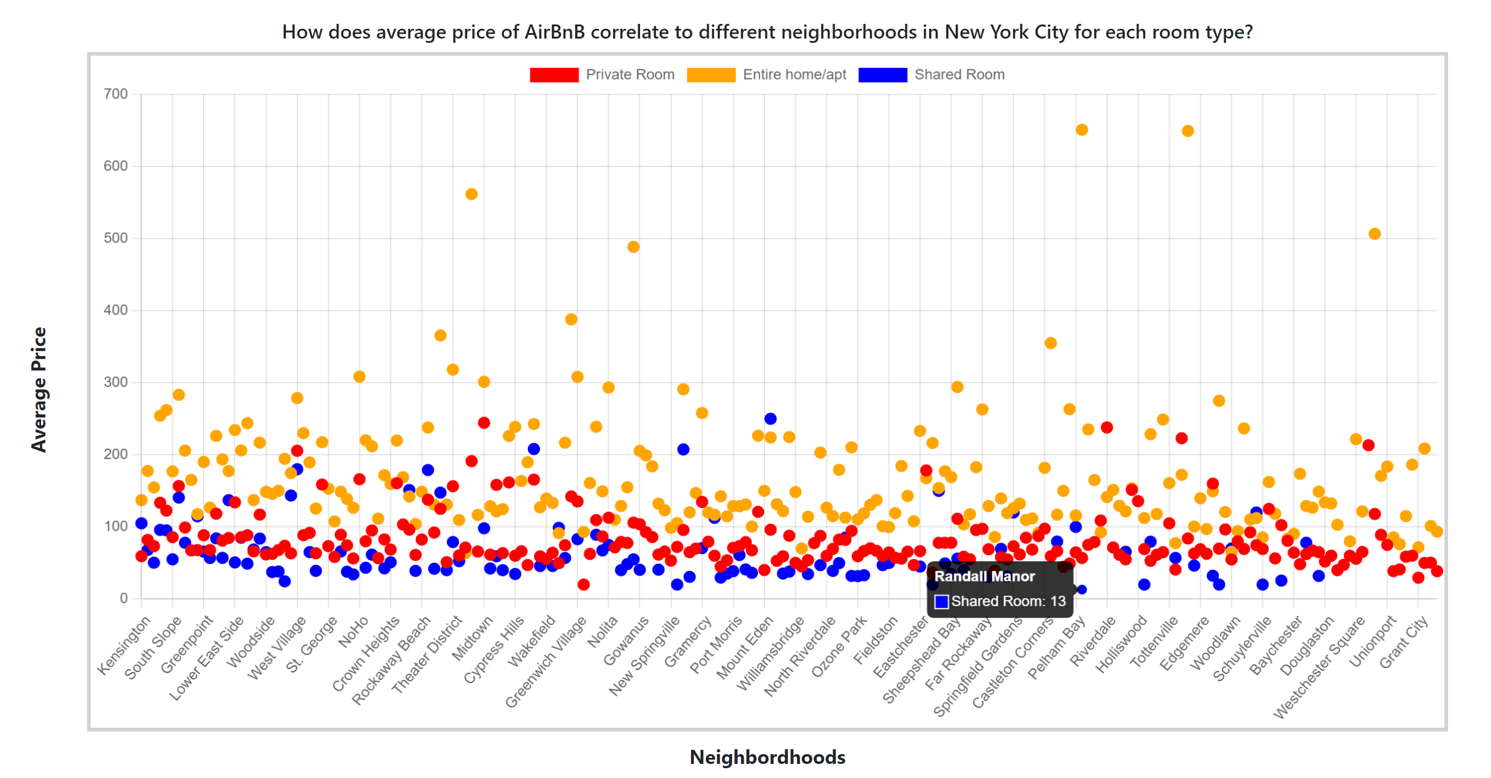

Slide 12
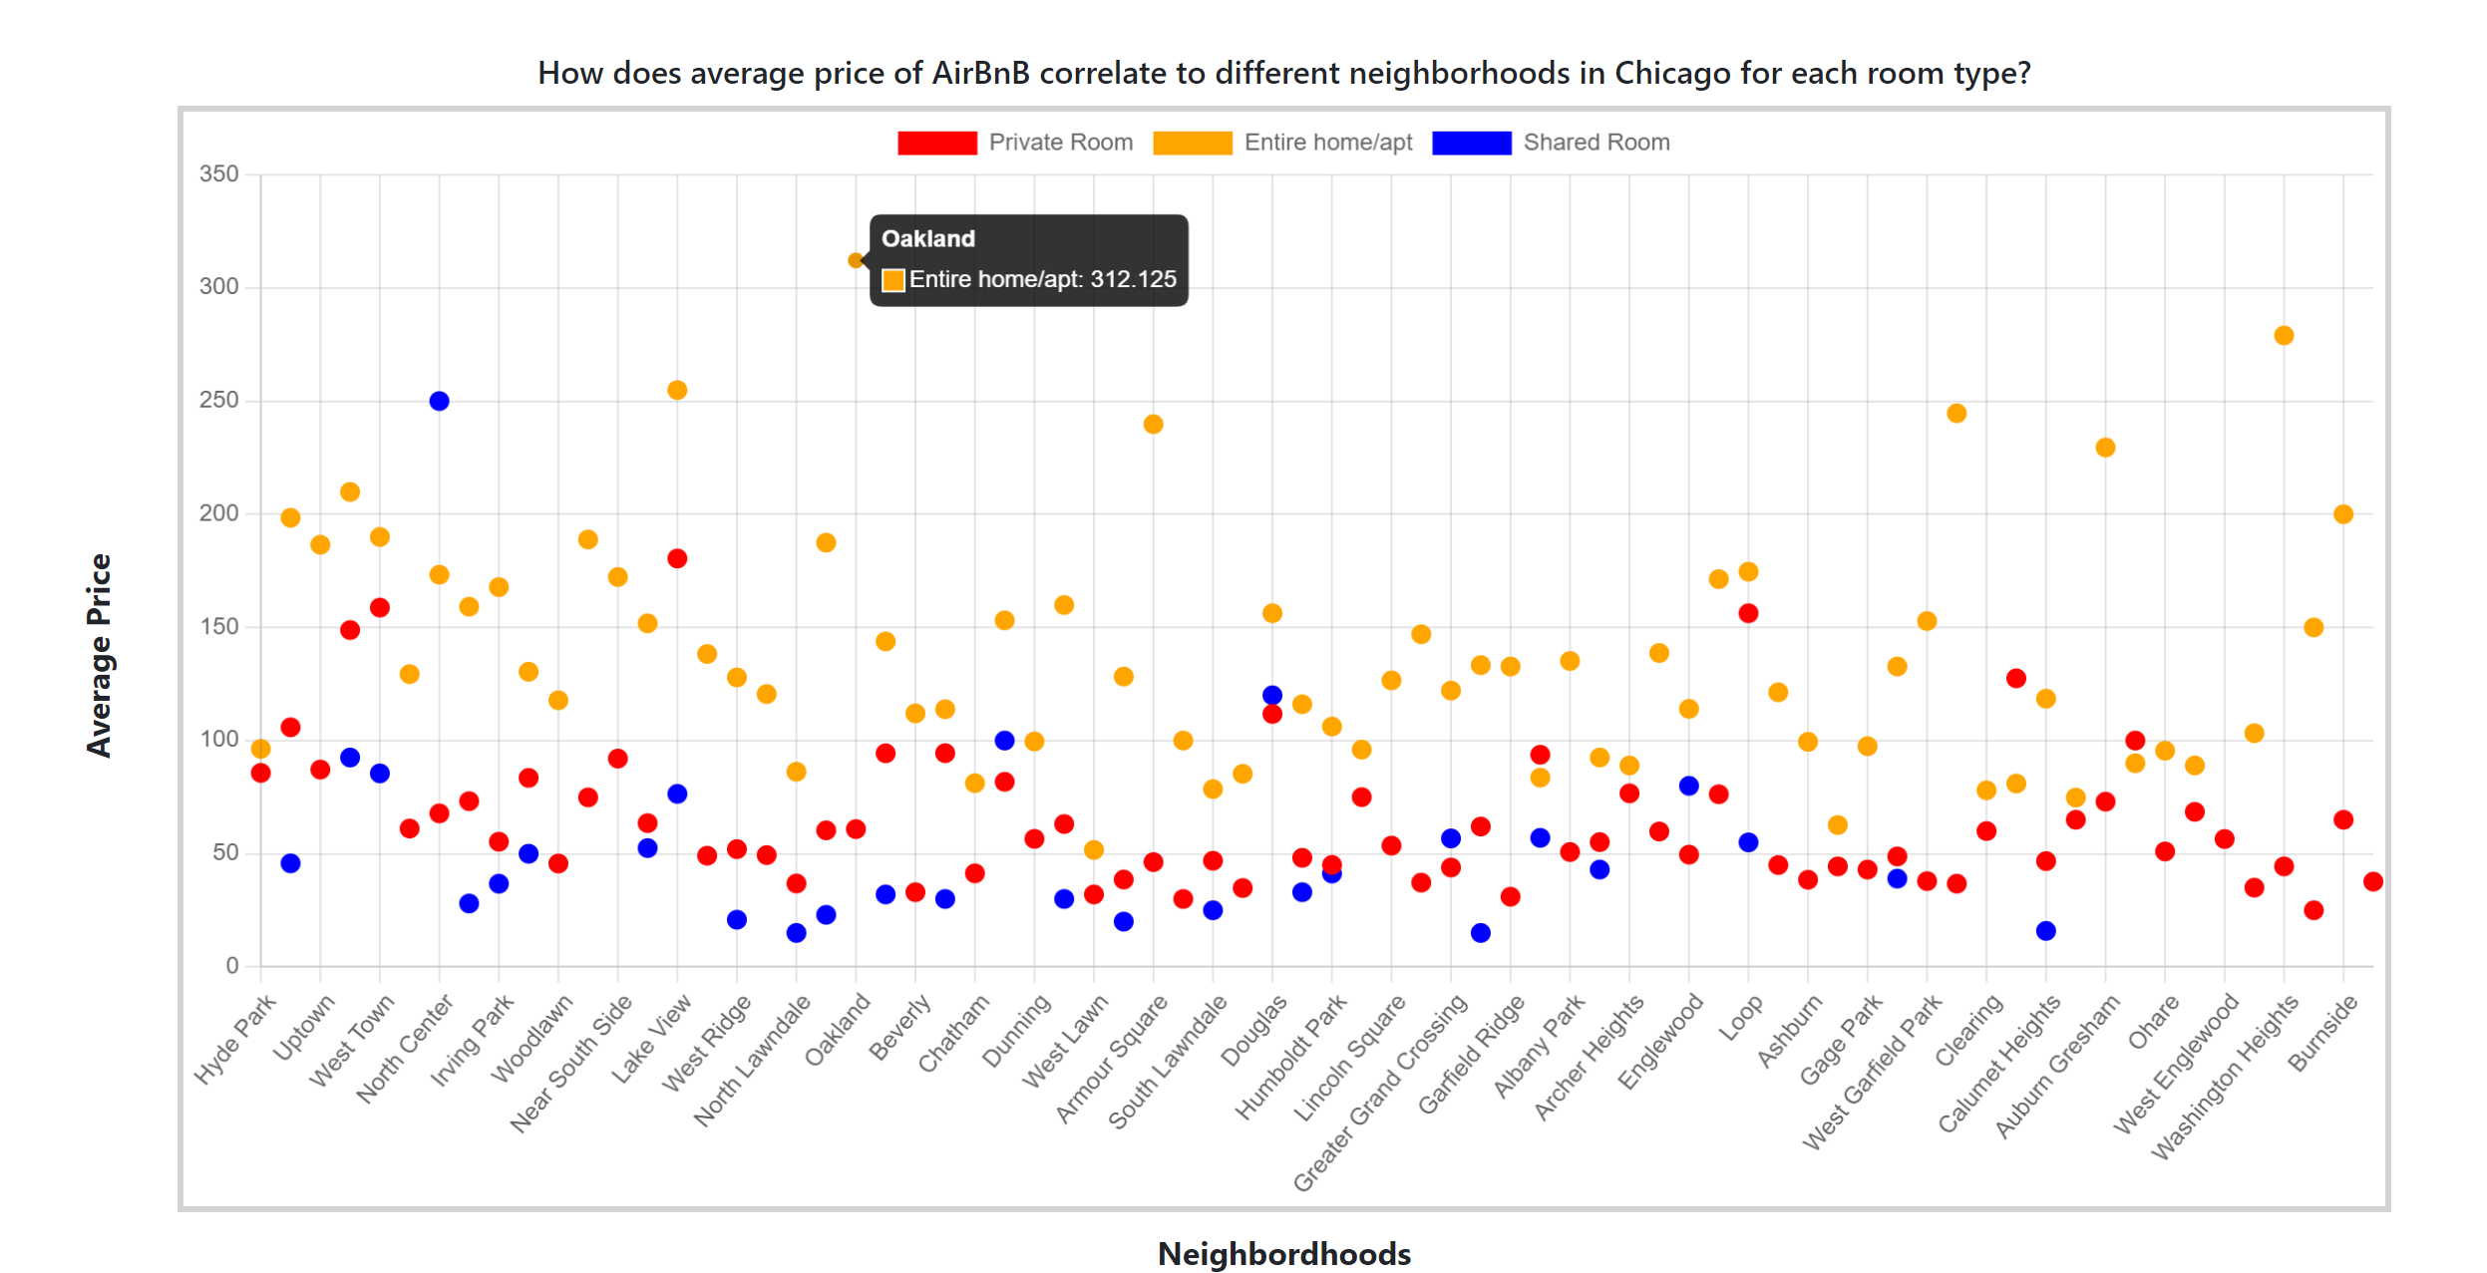

Slide 13

Limitations
Not much animations

Slide 14
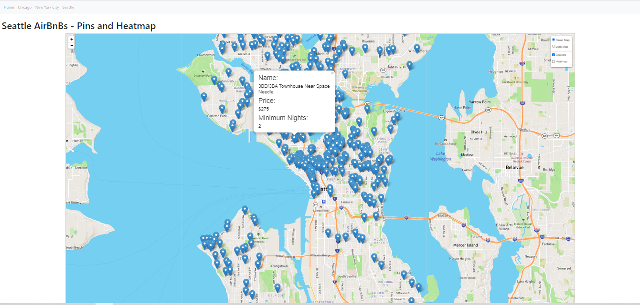
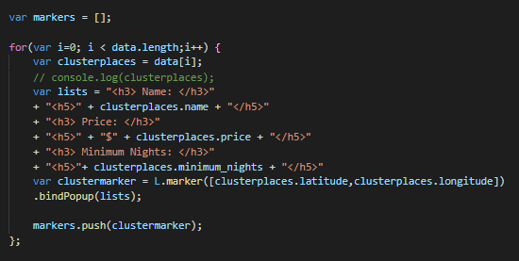
Pin Visualization

Slide 15
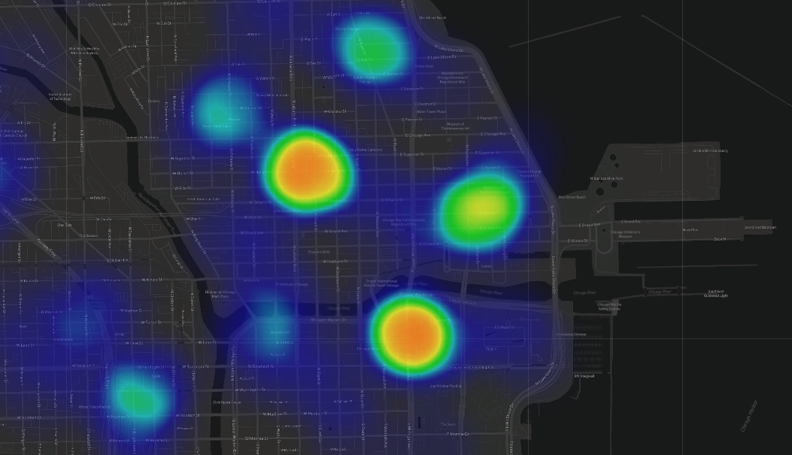
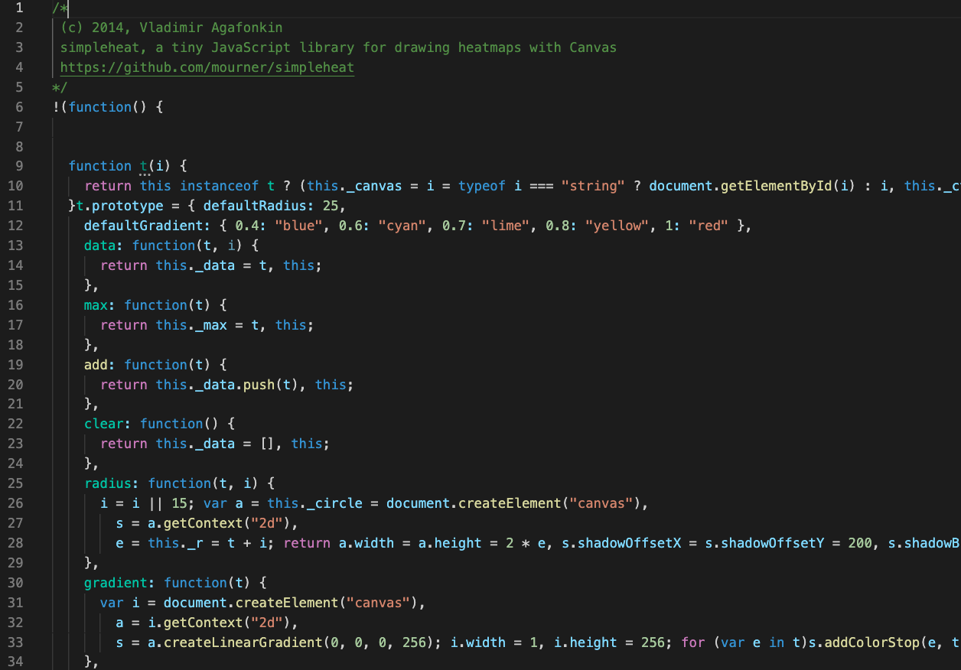
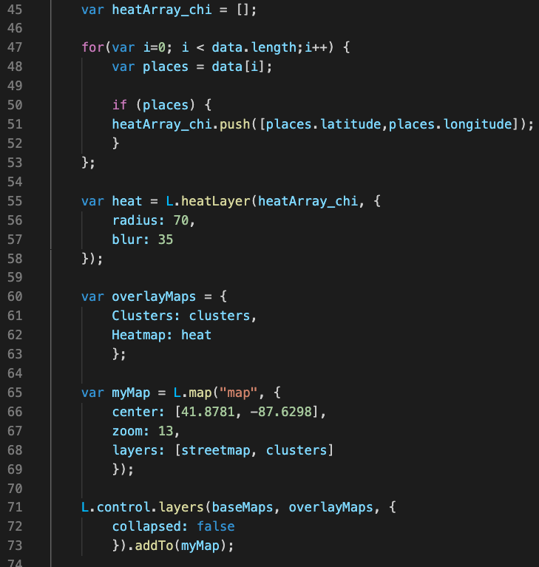
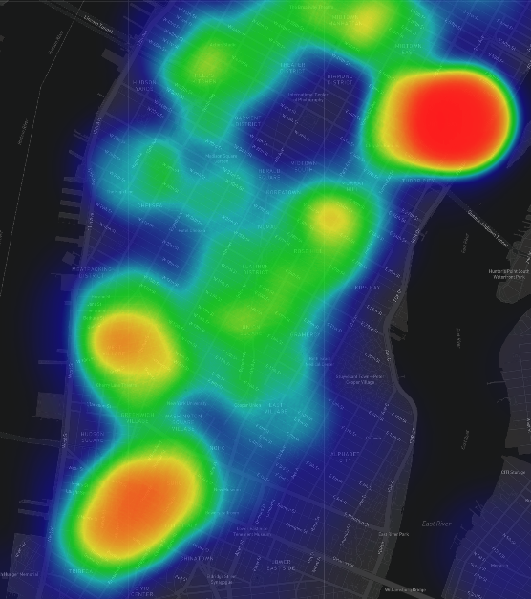
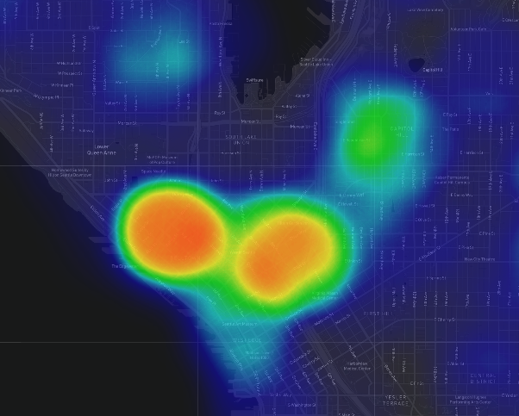
Heatmap Visualization
Helps visualize volume of AirBnB listings by location
CHICAGO
SEATTLE
NEW YORK CITY

Slide 16
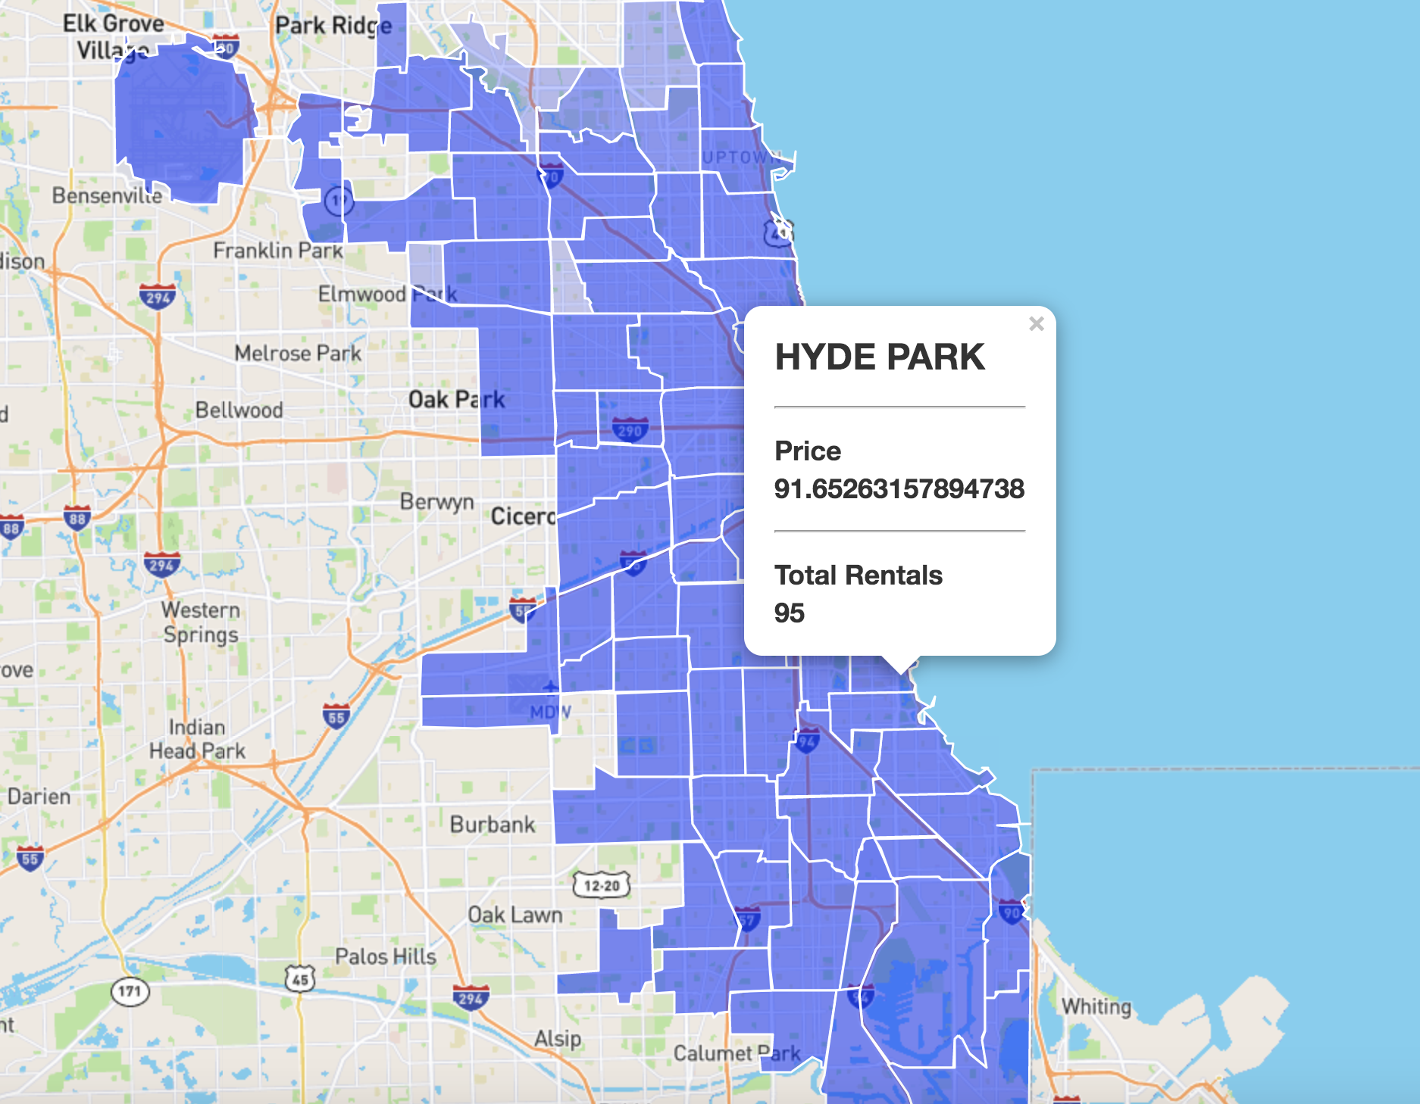
Grid Visualization
Helps visualize price by
neighborhood
Required extra data

Slide 17
LIVE DEMO

